Slide 1

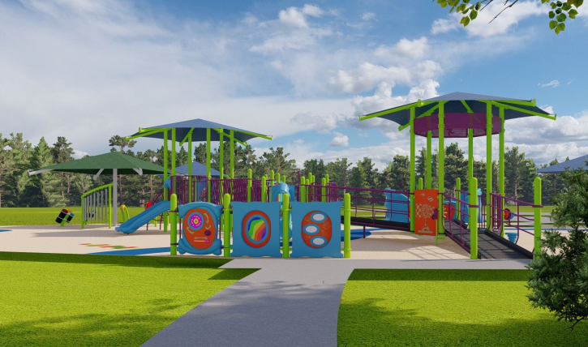
PROJECT OVERVIEW

Slide 3
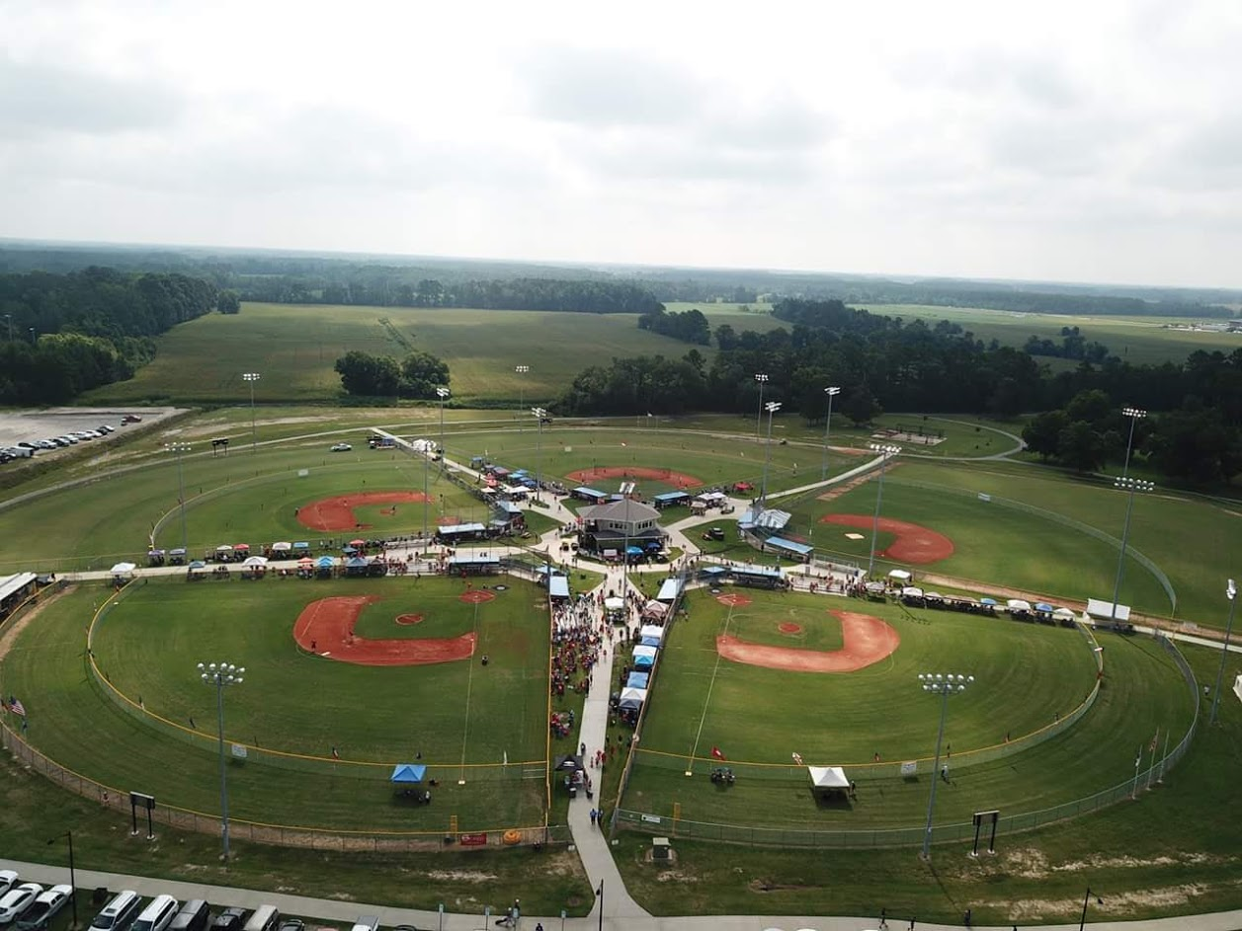
LEADERSHIP
The Kiwanis Club of Robeson Lumberton, in partnership with the City of Lumberton, is developing a new inclusive playground at the Dr. Raymond B Pennington Athletic Complex.
Optimized for children ages 2 to 12, the new playground features:
An advanced, Poured-In-Place rubber surface
Range of inclusive playground equipment
Perimeter fence for increased safety and security
The project is being developed in recognition of our Club’s 100 years of continuous service to the people of Robeson Lumberton.

Slide 4
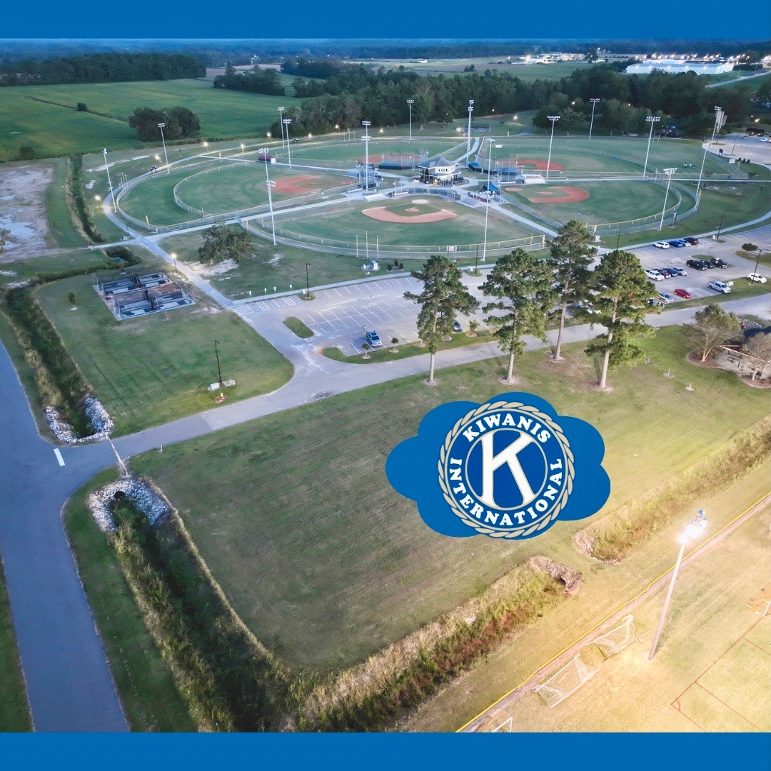
Proposed Site
“K” Marks the Spot

Slide 5
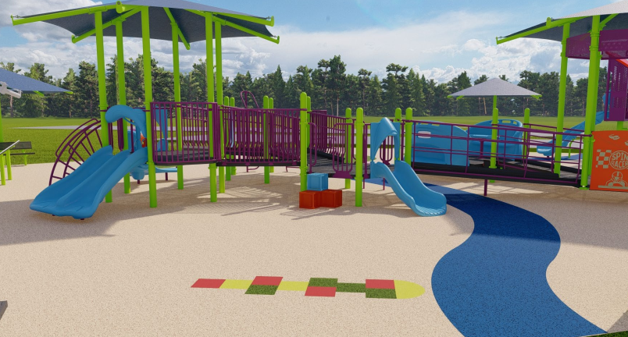
NEED
The new playground will ensure that all children in the Robeson Lumberton area have access to a range of recreational opportunities, regardless of their ability.
At present, however, there are no other playgrounds in the area that are optimized for use by children with physical, emotional, or social disabilities.
According to an article published in 2021, Public Schools of Robeson County serves 3,400 children who have physical, emotional or social disabilities. That’s over 10% of our total population of children under age 18 (US Census, Robeson County Quick Facts, July 1, 2022) We must step up for these children and families so that they can be socially, emotionally and physically healthy.

Slide 6
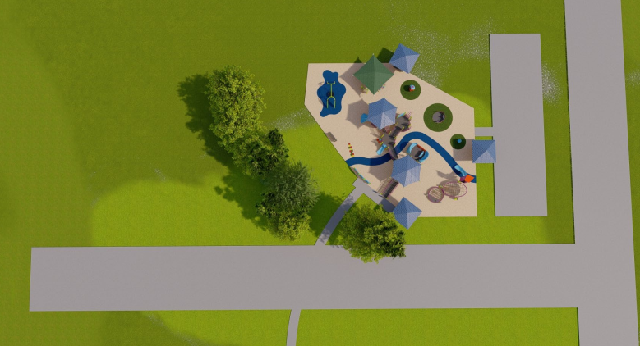

DEVELOPMENT
The Kiwanis Club has selected Playworld Preferred to be our ‘turn-key’ provider of all design, equipment and installation services.
Playworld is one of the leading providers of top-quality custom equipment, surfacing, site furnishings and shade for playgrounds across North America
In addition to being leaders in inclusive playground design and development, all Playworld equipment has been purpose-built to promote inclusion and accessibility among children with different abilities.

Slide 7
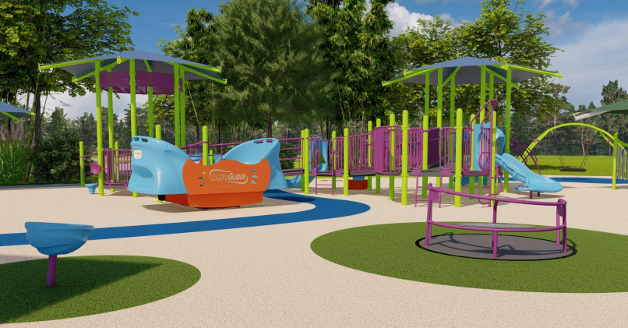
REQUIREMENTS
Estimated Cost to Develop: $489,000
Funds Raised to Date: $110,000
The City of Lumberton will continue to own the land on which the playground is located and will be responsible for ongoing maintenance and upkeep of the facility.
The City has also committed to providing a generous cash donation to support development of the project.
This is our timeline for development:
Funding Secured: April 2024
Ground-Breaking: May 2024
Grand Opening: June 2024

Slide 8
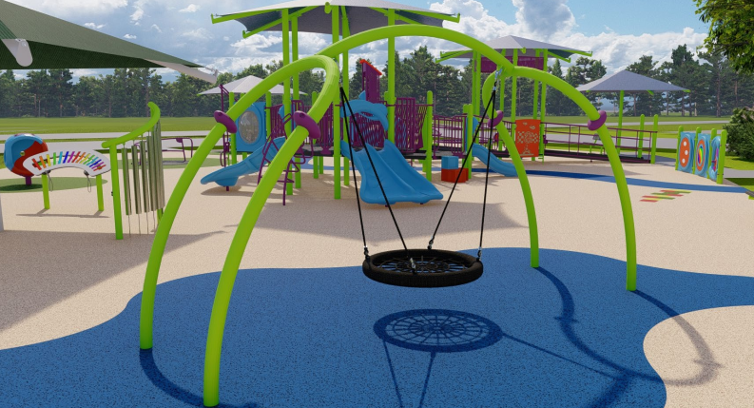
IMPACT
With its inclusive equipment, surfacing, and perimeter fence, the new playground at Pennington Athletic Complex will:
Provide access to a modern recreational facility for children with limited mobility, social and emotional and behavioral disorders, and/or those with Intellectual and Developmental Disabilities
Improve the physical, emotional and social health of children across the region
Exceed Americans with Disabilities Act standards for accessibility and safety
Act as a destination, attracting children, families and new investment to the area

Slide 9
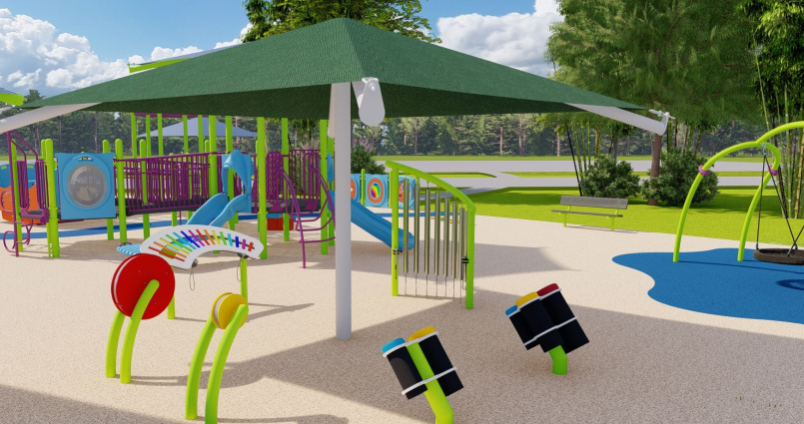
FUNDRAISING
The Kiwanis Club or Robeson Lumberton has launched a region-wide fundraising campaign to secure the funds needed to construct the new playground.
The campaign includes an aggressive program of grant writing, face-to-face solicitation, and event driven donations.
We are currently finalizing our plan to develop a permanent installation in Pennington Athletic Complex that will recognize the contribution of all major gift donors.
Potential donors are being invited to:
Make a one-time, lump-sum contribution
Sponsor the purchase of a piece of equipment

Slide 10
Playground Fundraising Campaign
LEVELS OF SUPPORT

Slide 11
Kiwanis Superhero: $50,000
Prominent placement on Permanent Recognition Sign at playground
Annual Dinner 'Thank You' plaque presentation & commemorative framed photo
Big check presentation on social media
Listing in 'Community Thank You' newspaper ad

Slide 12
Kiwanis Hero: $25,000
Placement on Permanent Recognition Sign at playground
Annual Dinner 'Thank You' plaque presentation & commemorative framed photo
Big check presentation on social media
Listing in 'Community Thank You' newspaper ad

Slide 13
Kiwanis Elite: $10,000
Placement on Permanent Recognition Sign
Special Mention at Annual Dinner
Big check presentation on social media
Framed certificate of appreciation
Listing in 'Community Thank You' newspaper ad

Slide 14
Children’s Champion: $5,000
Permanent Recognition
Special Mention at Annual Dinner
Big check presentation on social media
Framed certificate of appreciation
Listing in 'Community Thank You' newspaper ad

Slide 15
Gold Sponsor: $1,000
Framed certificate of appreciation
Listing in 'Community Thank You' newspaper ad
Silver Sponsor: $500
Listing in 'Community Thank You' newspaper ad
Bronze Sponsor: $100
Group acknowledgement in 'Community Thank You' newspaper ad

Slide 16
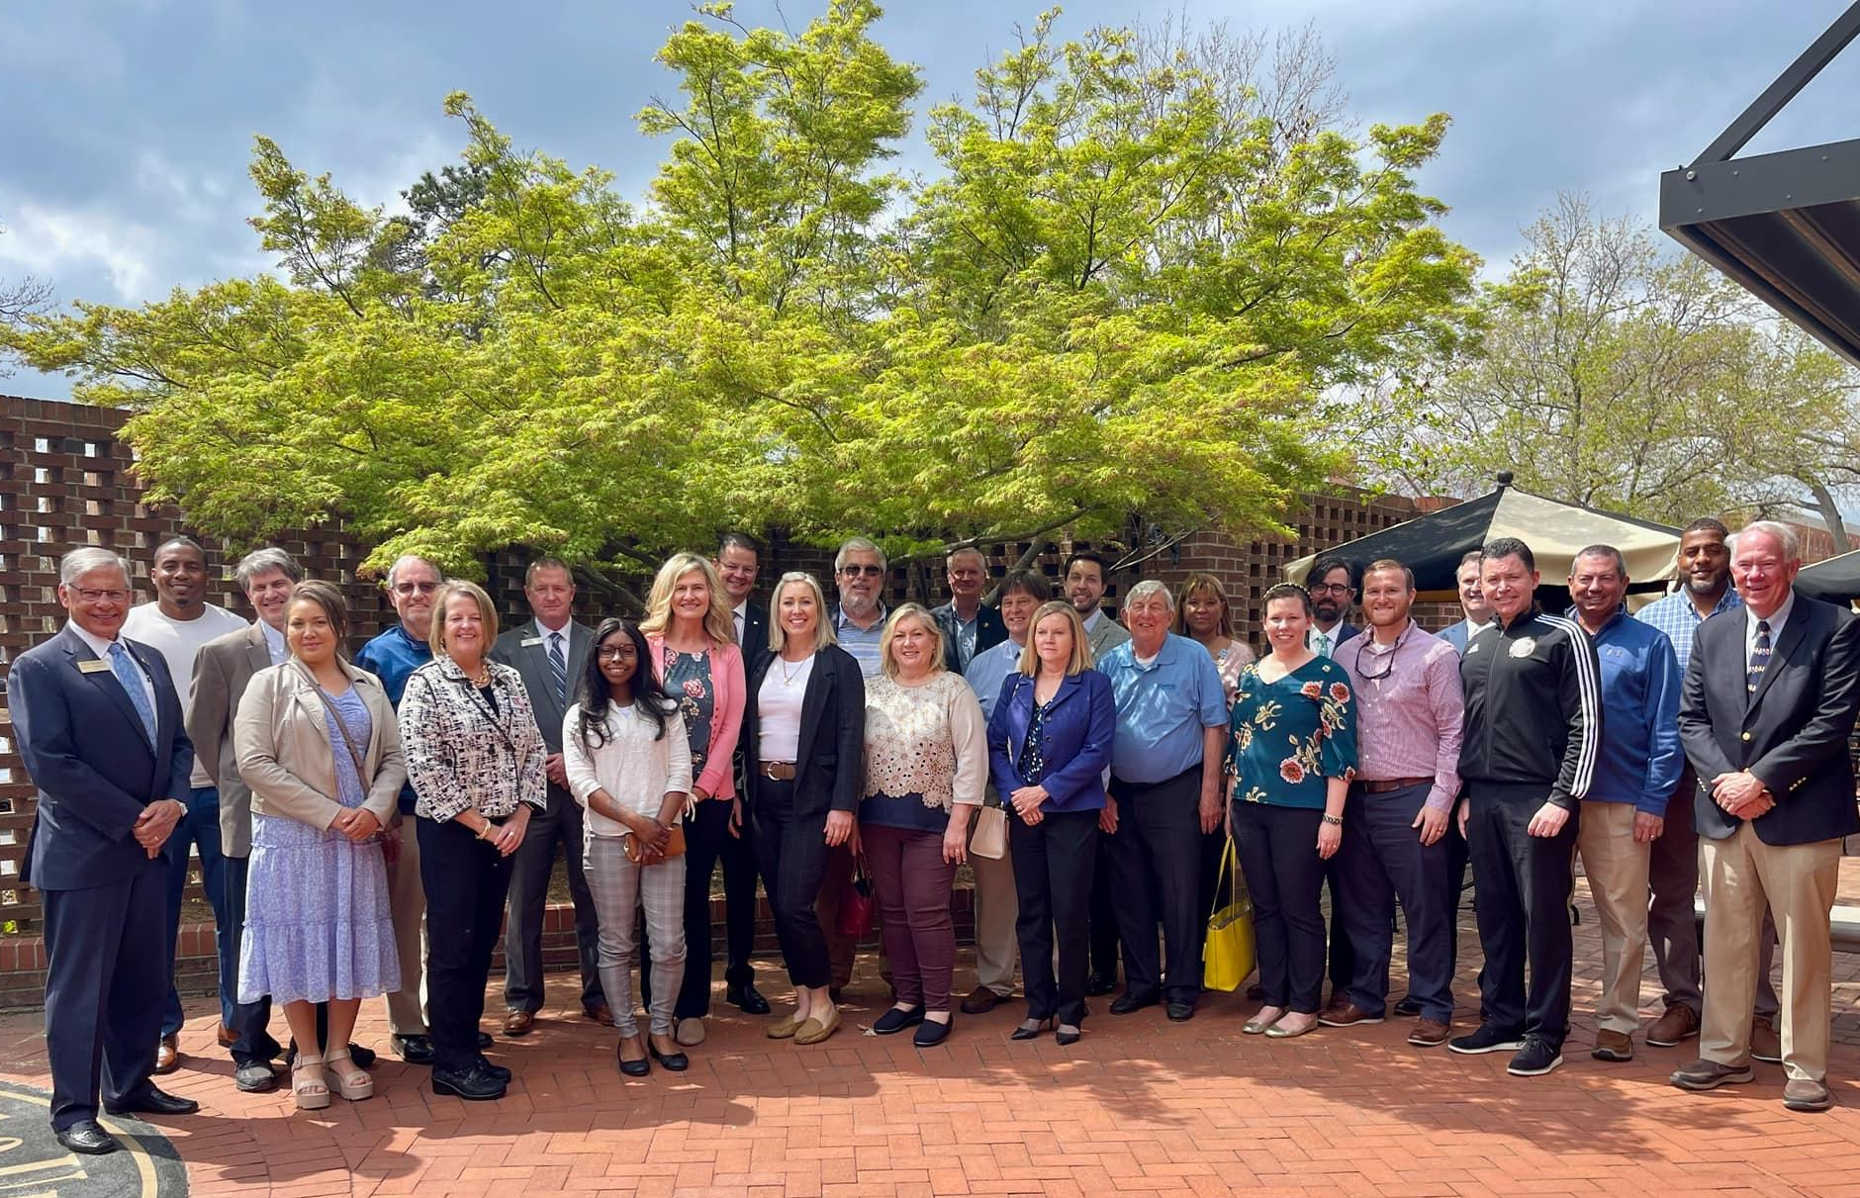
JOIN US …!

